Slide 1
PH160 LAB 3
Name : Snehal Keshav Nalawade
ID : 202151160

Slide 2
Aim : A] To Determine the factors which affect the period of oscillation.
B] Find the value of g on Planet X.
C] Describe the relationship between the velocity and acceleration vectors, and their relationship to motion, at various points in the oscillation.
D] Explain how the free-body diagram of the mass changes throughout its oscillation.
E] Explain the Conservation of Mechanical Energy using kinetic, elastic potential, gravitational potential, and thermal energy.

Slide 3
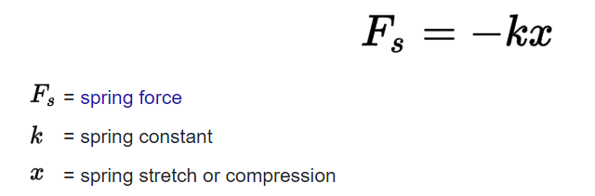
Theory : Hooke’s law is :
Where Fs = mg also
A] The period of a vertical spring-mass system is given by :
T = 2π*[sq.rt(m/k)]
Therefore T is proportional to the square root of the mass and inversely proportional to the square root of the spring constant(k). K is inversely proportional to the length of the spring, therefore T also depends on length of the spring (L).
This dependence of T on various factors is seen in the observation table where the spring constant (k) is calculated by the following relation :
k = (m*g)/x

Slide 4

B] the time period does not depend upon the acceleration due to gravity. Also the spring constant k depends on the material of the spring and it’s natural length. So, if same mass is taken, the time period of oscillation will also be nearly equal (the slight changes will be due to the slight variance in the average and exact values of g on planet X).
the value of k will be same at all places and planets. Hence the experiment is first conducted on earth and the value of k is calculated using the other known quantities. Then this value of k is used to find out the value of g on planet X.
C] In case of a vertical spring mass system undergoing oscillations (with damping=0), the acceleration (a)
is given as:
or ma = -(kx + mg)
D] The forces acting on the oscillating mass are : gravitational force and spring force. The free body diagram of the mass will thereby show these two forces.
E] The spring mass system shows conservation of total mechanical energy . It is the sum total of the gravitational PE, Elastic PE, KE and Thermal energy at any time t. During the oscillation, some of these individual energies decrease at certain positions while the rest increase, thereby conserving the total ME of the system.

Slide 5
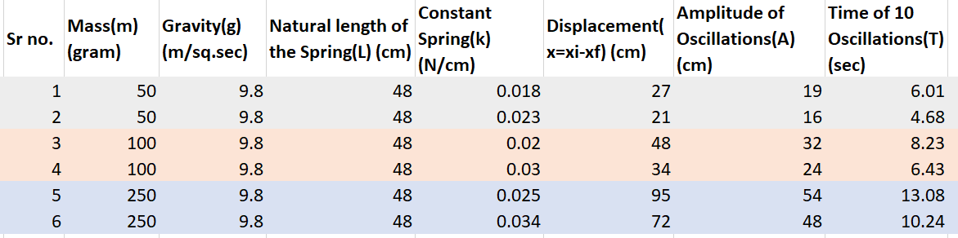
Observations and Calculations :
A]
Since displacement and amplitude are results of oscillation of a vertical Spring mass system, therefore they cannot be the factors affecting the time period of this system. The dependence or independence of T on other factors is checked by performing several experiments whose observations are tabulated below :
a) The dependence of T on spring constant(k) is checked by making 3 pairs of observations where the mass and other quantites are kept same in each pair and only k value is varied.
Since T varies with k , therefore time period depends on spring constant.

Slide 6
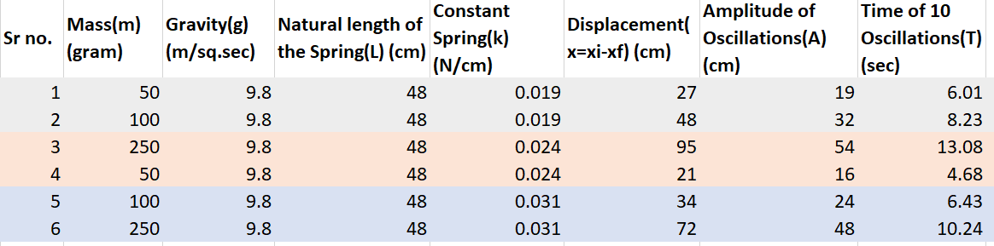
b) In this case, mass is varied in each pair of observations and other quantities are kept constant.
As mass varies, T also differs. Therefore T depends on mass as well.

Slide 7
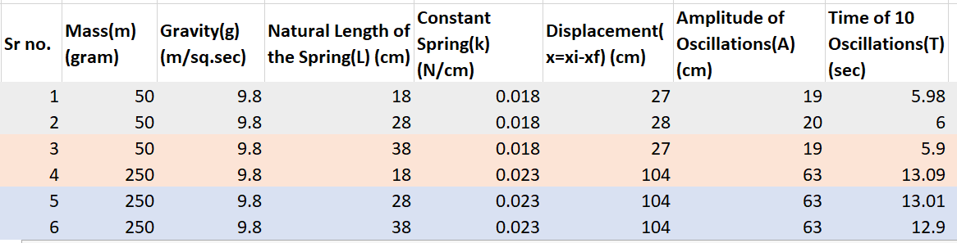
c) now, natural length of the spring is varied while keeping the other quantities constant.
From this table, we conclude that T depends on natural length(L) of the spring too.

Slide 8
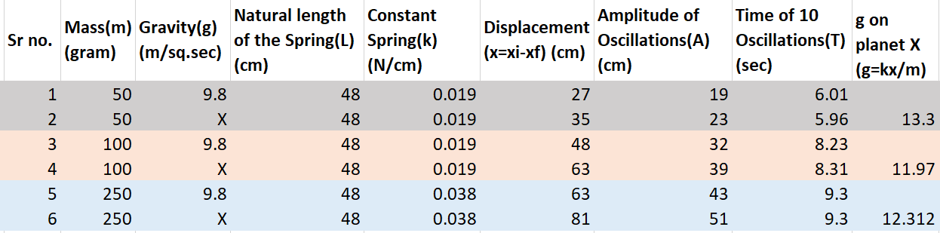
B] In order to calculate the value of acceleration due to gravity on planet X, first the value of k for the corresponding spring is calculated by using the acc. due to gravity on earth and then the value for g on planet X is calculated.
The value of g on planet X is calculated in different cases . Now, we will calculate the average of all the g values of X that we got during the experiment, in order to get a more accurate value.
Therefore, g = (13.3 + 11.97 + 12.312)/3
= 12.527 m/sq.sec

Slide 9
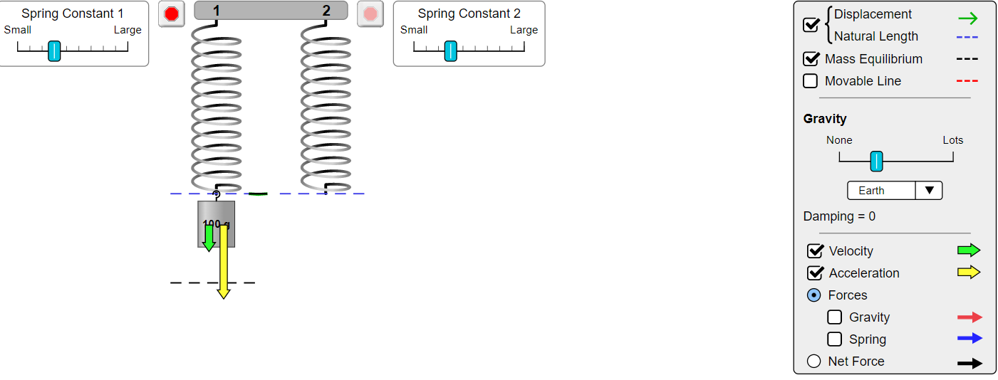
C] Relation between the velocity and acceleration vectors and their relation to the motion of the mass at various points :
a) When the mass is just released :
Velocity and acceleration vectors are directed downwards. Since motion is always in the direction of velocity, therefore motion of the mass is also downward.

Slide 10
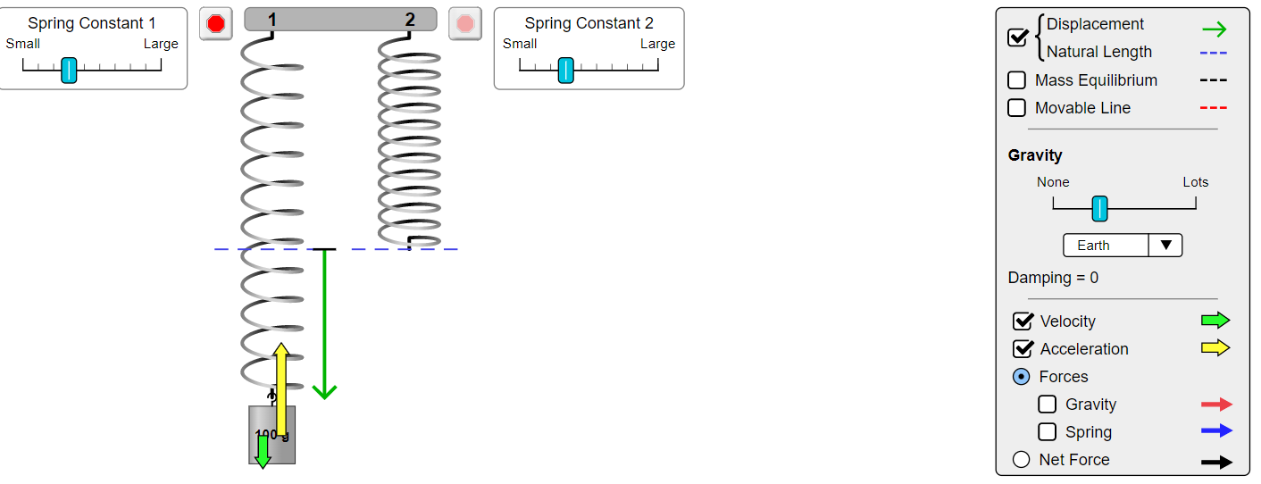
b) When the mass is moving downward from the equilibrium position towards the extreme position :
Velocity vector and thereby the motion of mass is directed downward while acc. vector is directed upward.

Slide 11
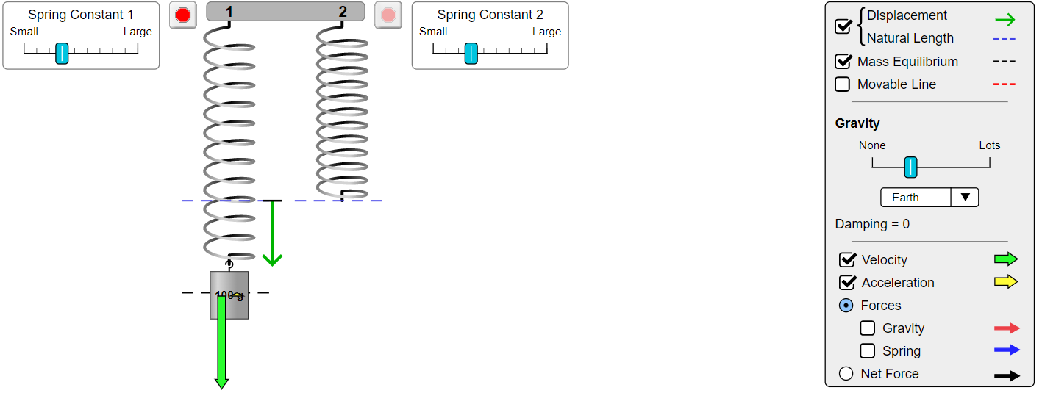
c) When the mass reaches the equilibrium position :
Velocity is equal to zero (instantaneously) and the mass is at it’s equilibrium position. The acc. vector is directed downward and it’s magnitude is maximum. displacement from mean/equilibrium position is zero.

Slide 12
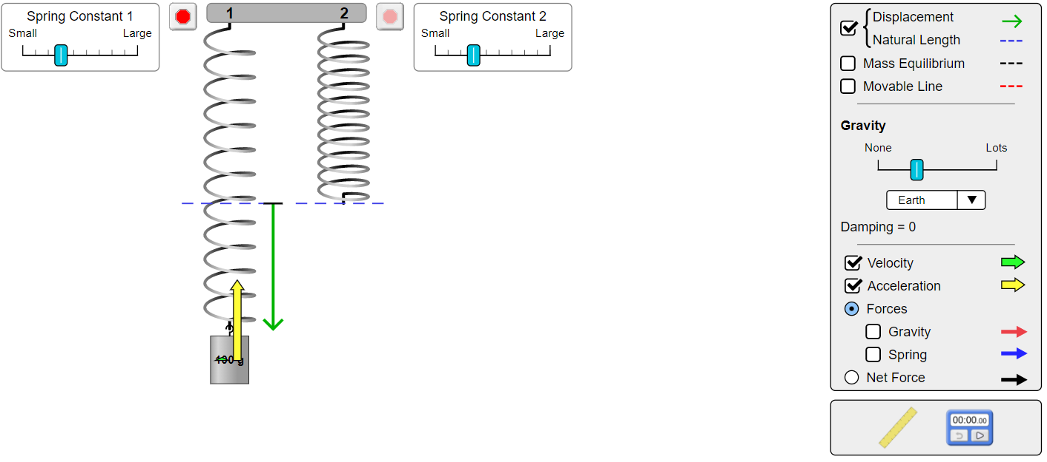
d) When the mass is at bottommost extreme position :
Velocity and motion of the mass are directed upwards and velocity’s magnitude is maximum. acceleration is instantaneously equal to zero. Displacement of the mass is downward from the equilibrium position.

Slide 13
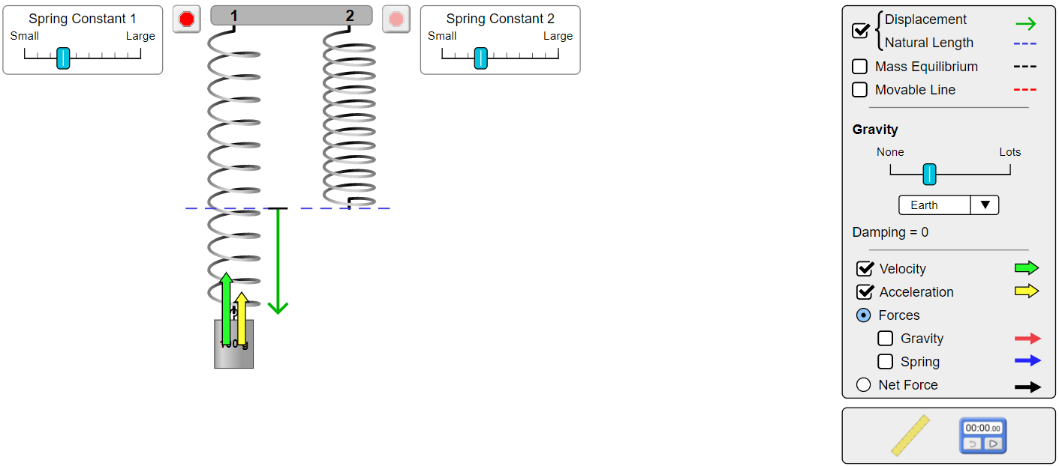
e) When the mass is moving upward from the extreme position towards the equilibrium position :
Velocity and acceleration vectors are directed upwards. Since motion is always in the direction of velocity, therefore motion of the mass is also upward. The displacement of the mass however is downward from the equilibrium position.

Slide 14
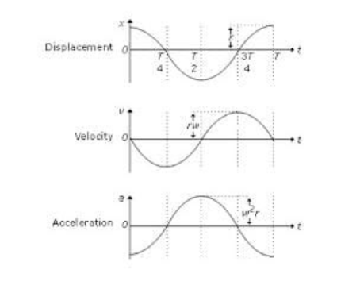
The x-t, v-t and a-t graphs of this spring mass system will be sinusoidal, as shown below :

Slide 15
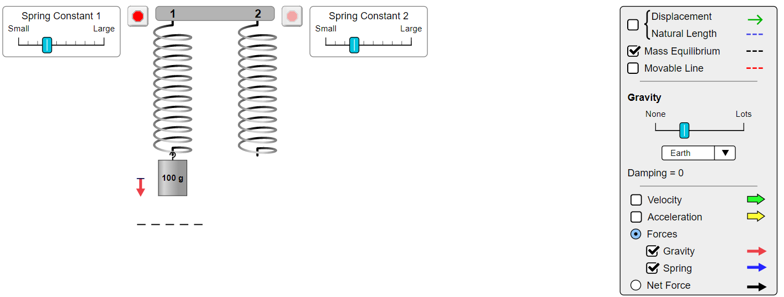
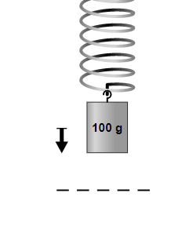
D] Throughout the oscillation of the spring mass system, there are total two forces which act continuously on the mass – one is due to the gravity of the planet(in this case, Earth) and the other one is due to the elasticity of the spring.
The corresponding free-body diagram of the oscillating mass at different positions is :
a) At the instant when the mass is just released :
The net force on the mass :

Slide 16
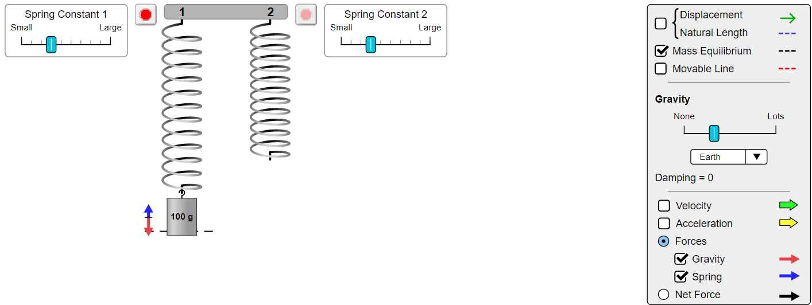
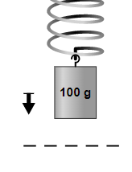
b) While the block is moving downwards towards the equilibrium position :
The net force on the mass :

Slide 17
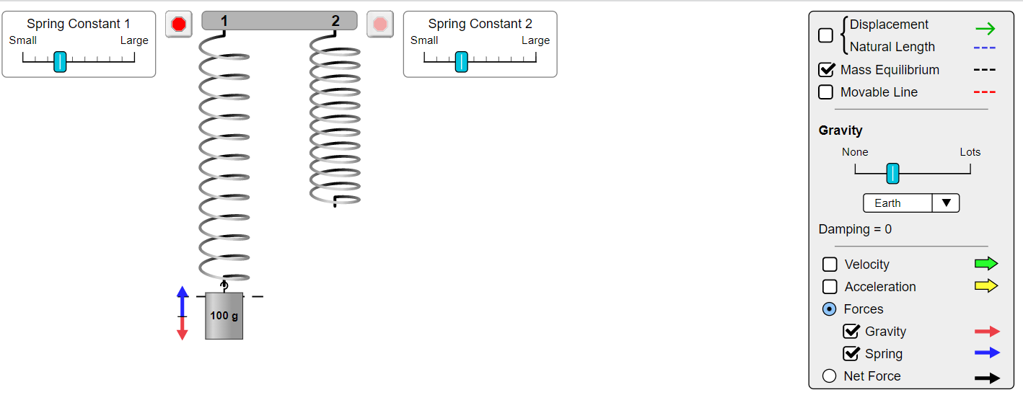
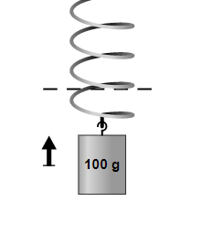
c) While the block is moving downwards from the equilibrium position to the bottommost extreme point :
The net force on the mass :

Slide 18
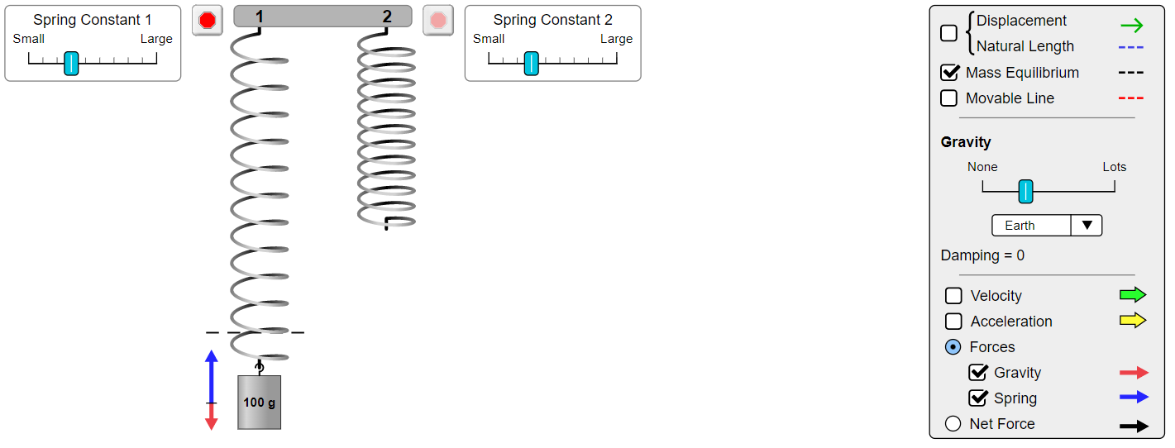
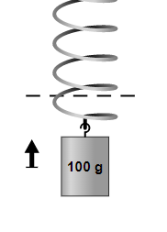
d) When the mass is at the bottommost extreme position :
The net force on the mass :

Slide 19
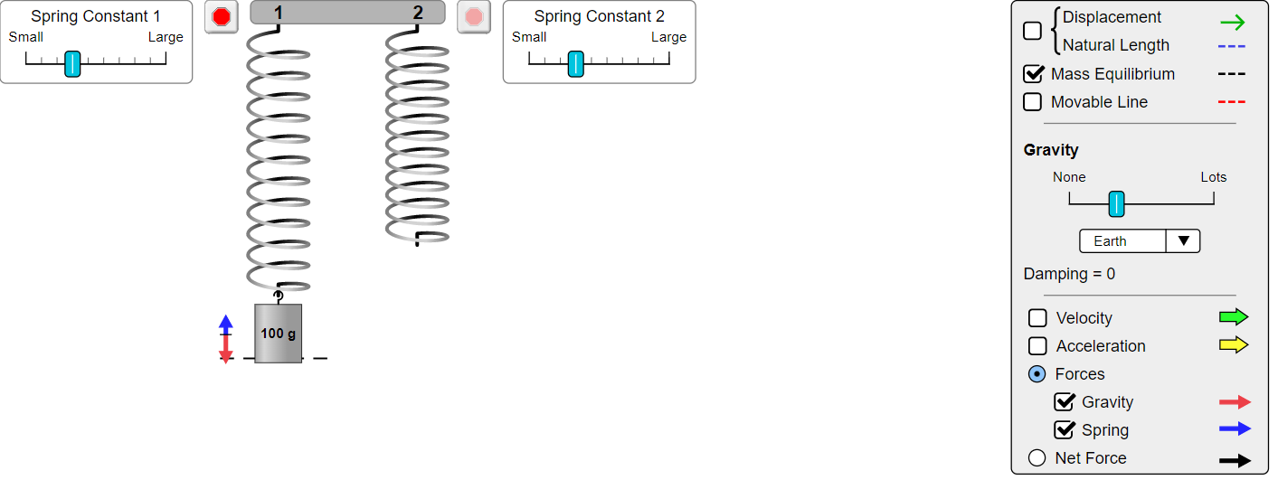
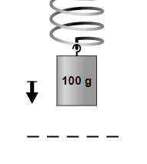
e) When the mass is moving upwards from the equilibrium position to the uppermost point :
The net force on the mass :

Slide 20
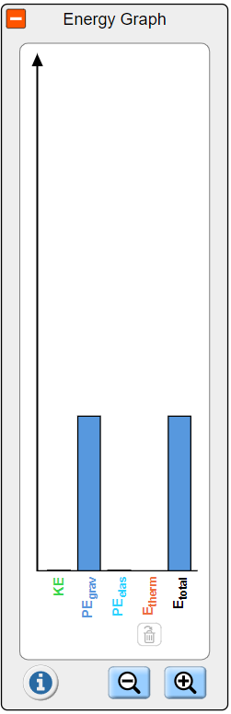
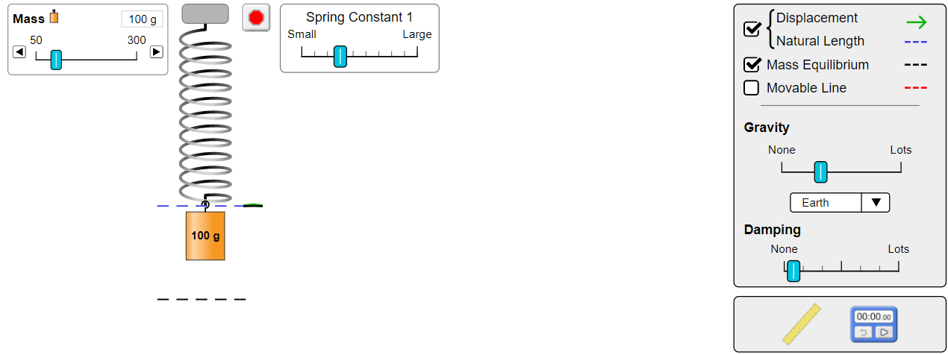
E]
a) When the mass is just released : entire energy of the system is stored in the form of gravitational potential energy.

Slide 21
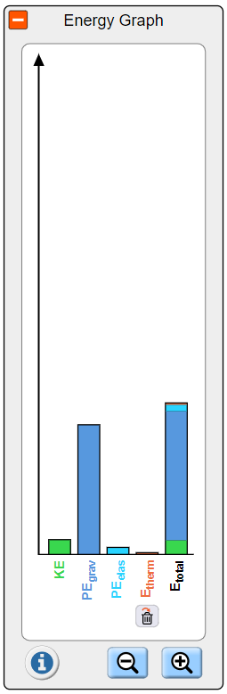
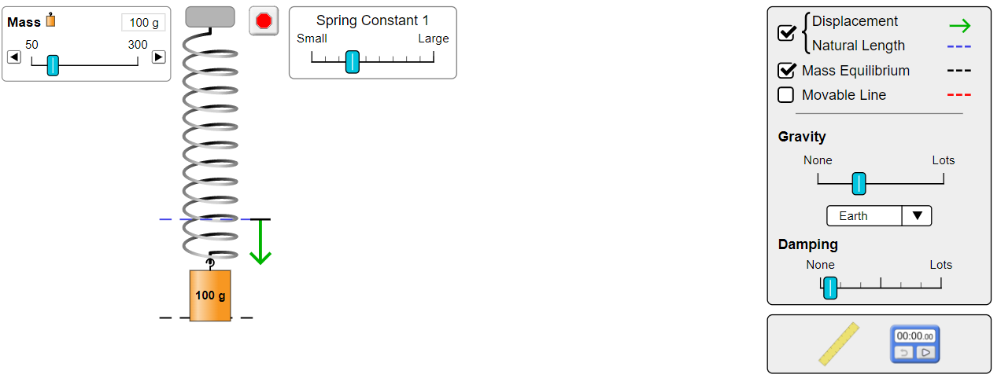
b) When the mass is moving downward : now, elastic potential energy, some amount of thermal energy and kinetic energy also come into being alongwith the gravitational energy. The total mechanical energy of the system will now be the sum total of all these energies.

Slide 22
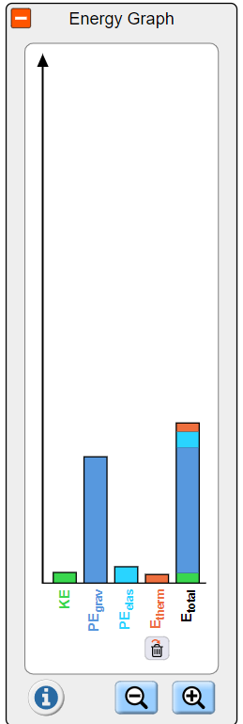
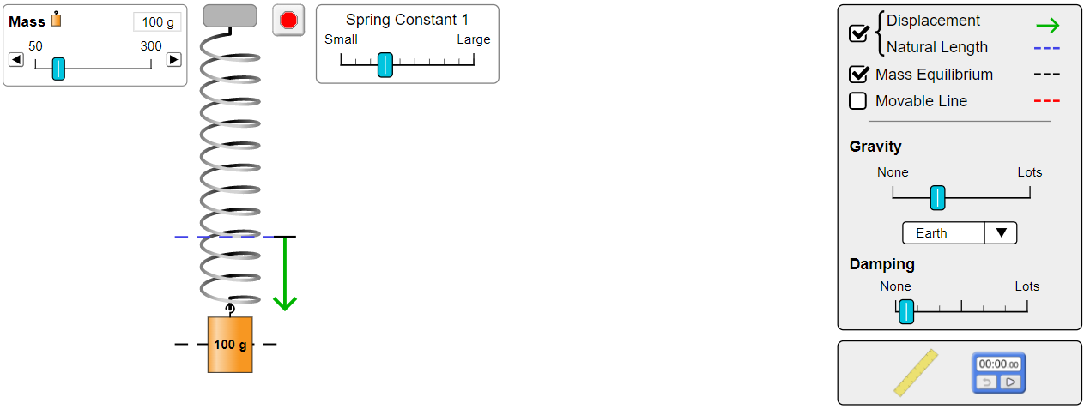
c) When the mass reaches the equilibrium position : here, maximum possible value of kinetic energy is attained.

Slide 23
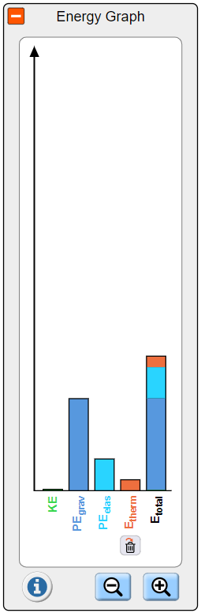
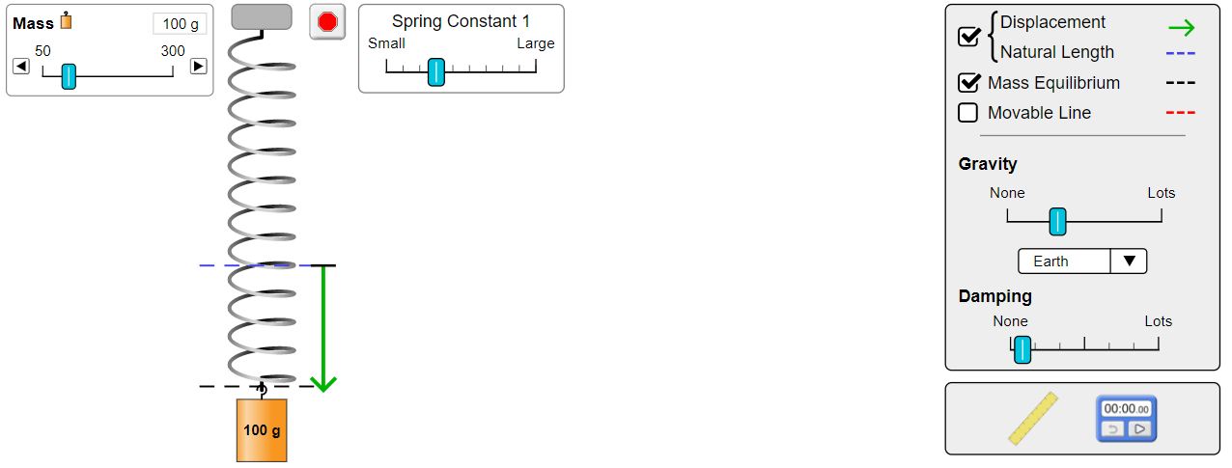
d) When the mass is at bottommost extreme position : the kinetic energy is zero here (since velocity=0) and the potential energy is also minimum since it is the bottommost point (height from ground is minimum). The elastic potential energy is maximum due to the extensive stretching of the spring by the mass.

Slide 24
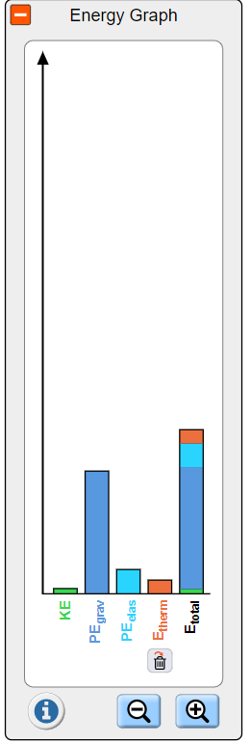
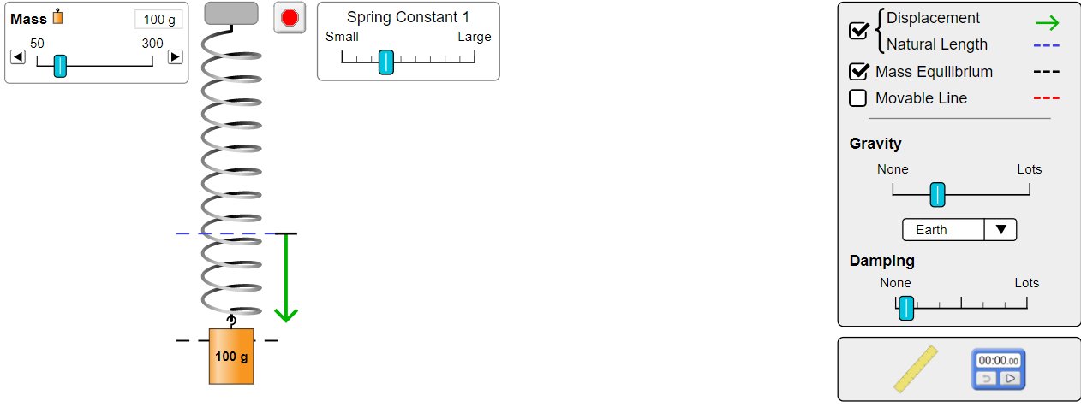
e) When the mass is moving upward from the extreme position to the equilibrium position :

Slide 25
If we see all the five cases above, the KE, Thermal Energy, Elastic PE and Gravitational PE vary throughout the motion. The total mechanical energy of the system will be equal to the sum total of all these energies. If we measure the first four energies mentioned above and add them, the total ME that we get in each of the five cases is graphically plotted below. It is evident from the graphs that the total Mechanical Energy of the system remains conserved throughout the oscillatory motion.

Slide 26
Error : Since the experiment is done using an online simulator, therefore no error is observed. Had the experiment been done practically, the slight differences in the exact and measured values of various quantities would have caused error.
Result analysis : The performed experiment and it’s results (as seen in the above tables and graphs) demonstrate the various properties and relations related to the oscillation of a vertical spring mass system (for example, Hooke’s law)
Thank you

